Slide 1


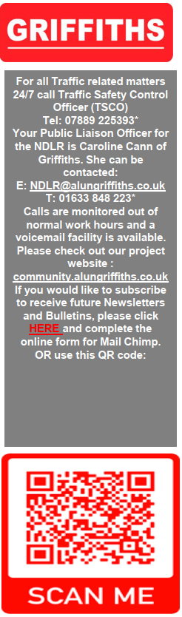


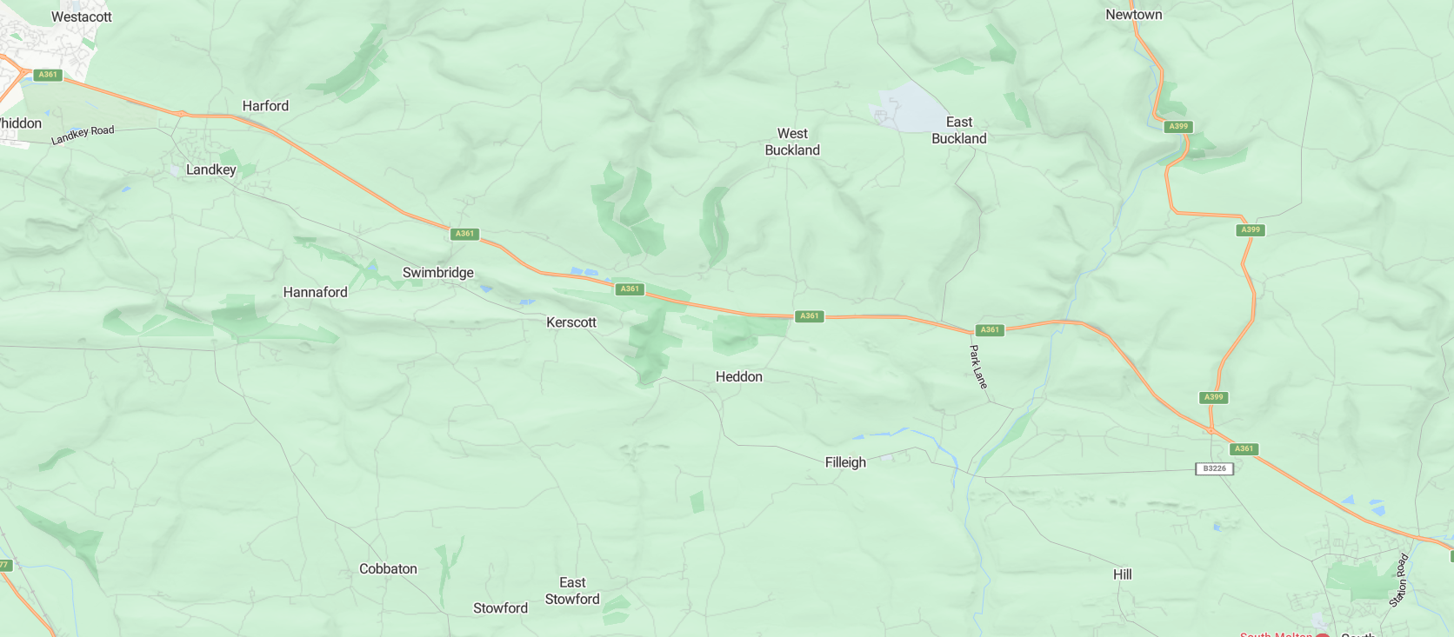
No road closures of the A361 are planned.
Traffic management will be deployed for the following times:
-- Sun-Mon 20:00hrs to 06:00hrs
-- Mon-Tue 20:00hrs to 06:00hrs
-- Tue-Wed 20:00hrs to 06:00hrs
-- Wed-Thu 20:00hrs to 06:00hrs
-- Thu-Fri 20:00hrs to 06:00hrs
-- Fri-Sat 20:00hrs to 06:00hrs
All traffic management will be removed during the daytime throughout the week.
Traffic management being used will include:
-- 2-way temporary traffic lights which will be attended to minimise disruption
-- lane closures on widened sections which will maintain the flow of traffic in both directions
-- two lanes on the roundabouts at Landkey and Borners bridge will be reduced to a single lane with cones
North Devon Link Road
Traffic Bulletin
March 2025
Our Public Liaison Officer, Caroline Cann can be contacted on:
E: NDLR@alungriffiths.co.uk
T: 01633 848 223*
Calls are monitored out of normal work hours and a voicemail facility is available. Please check out our project website:
community.alungriffiths.co.uk
If you would like to subscribe to receive future Newsletters and Bulletins, use this QR code:
From week commencing 24th March 3-way traffic lights will be in use overnight on the A361 at West Buckland junction to enable finishing works to be safely completed. This arrangement will be in use for a period of 4 weeks. Turning traffic may be diverted over the bridge via the traffic lights.
2-WAY TRAFFIC LIGHTS
PORTMORE ROUNABOUT
LANE CLOSURE
LANDKEY ROUNDABOUT
LANE CLOSURE + TRAFFIC LIGHTS
3-WAY TRAFFIC LIGHTS
LANE CLOSURE
WEST BUCKLAND JUNCTION
BORNERS BRIDGE ROUNDABOUT
NORTH ALLER ROUNDABOUT

